Slide 1
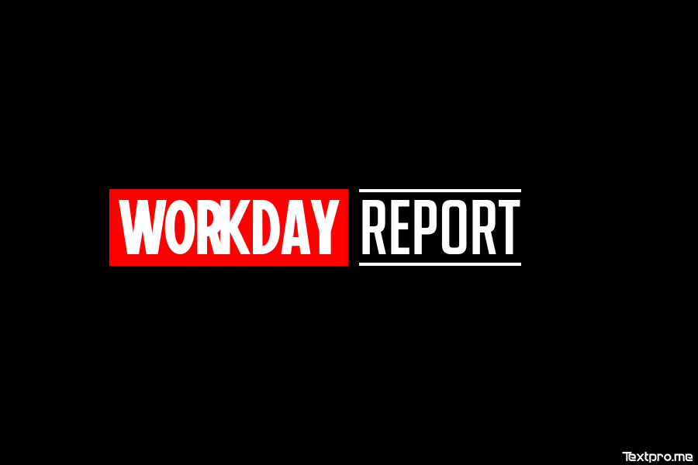

Slide 2


Slide 3






Underrated Superhero of Workday Reportverse
(just like Warmachine)
Only Primary Business Object
Allows Sorting
Allows simple filtering
Upgradable to Advanced Report

Slide 4





Most called upon Workday Reportverse Superhero
(just like Iron Man)
Primary Business Object and Related Business Object
Advanced Sorting
Advanced filtering with Prompts
Sharable
Visualization options
Advanced options like Worklet, Web Service Enabled and much more

Slide 5




Combine data from multiple reports (universe)
(Just as Sorcerer Supreme Dr. Strange)
Combine multiple reports into 1 report
Each sub-report can have different data source

Slide 6




Reportverse hero ready to dig in deep
(just like Ant Man)
Group and summarize based on few parameters (fields)
Drill down
Advanced filtering with Prompts
Sharable
Can display as table or chart
Advanced options like Worklet, Web Service Enabled and much more

Slide 7


Looking for a certain event, job or worker
Let’s find them as easy as Star-Lord navigates universe
Search Business Objects by term and facet filters
Pre-filter business object for search
Sharable
Search reports can be enabled as Web Service in Outbound EIBs

Slide 8




Let’s cut and divide data into nice boxes (Just like Hawkeye’s arrows)
Divides business objects into 2-Dimensional Box
Compares and Visualizes objects across 2 fields

Slide 9



Spotting trend in the data can help mine insightful scenarios (Just like Captain, this report can tell you a lot has changed in years)
Analyze trends in the data by time period
Group and summarize based on few parameters (fields)
Drill down
Advanced filtering with Prompts

Slide 10



Making task of comparisons easy as eating pie
(Just as simple as Black Widow travelling between countries)
Transpose rows to columns
Compare parameters (fields) for selected business objects

Slide 11


 | Report Specific | Tenant Wide
 | Calculated fields within the context of a specific report | Calculated fields available everywhere within tenant
Pros | Keeps BO cleaner for less used fields | Fields available everywhere (Condition Rules, Reports etc.) Easier to migrate
Cons | Can’t be used anywhere other than specific report Deep nested fields can cause issues while migrating | More the calculated fields, more time it takes to search

Slide 12

Report Specific Calculated Field
Tenant Wide Calculated Field
Convert Calculated Field for Report

Slide 13



Freeze First Column
Freeze the first column in report, making navigating easier in a report with multiple columns
Exclude Execution Link from Search
Hide link from global search. Enables you to create report that are used only as worklet within dashboards, sub-reports or in embedded analytics

Slide 14


Enable Save Parameters
Remember all the prompt options and quickly use them. Saves precious keystrokes
Enable Preferred Currency
Displays preferred currency value in second line, saving time on conversions

Slide 15


IN THE
Grid Preferences
Allows Report Writer to create one report with options for the end user to customize the layout and output further. Any change done on layout is saved and allows custom report views
Allows Freezing columns
Allows reordering
Allows hiding columns
Though this option is only available if you don’t have grouped columns in Advanced Report (reference)

Slide 16



Maintain Custom Reports on Menus
Add custom reports to contextual menu (related actions menu) or sitemap.
To add custom report to contextual menu:
Associate with only 1 business object and 1 action category
Have prompt on the report
You can only configure maximum of 100 custom
report on Workday Menus, so use the power carefully

Slide 17


Custom Report > Translate
Translate custom report from default language into other languages configured for tenant. Following can be translated:
Column heading override
Sort fields
Prompts
Report name
Output help text

Slide 18
Translation > Translate Instance
Using the related actions on custom report, following can be translated:
Brief Description
Instructions
Label Override
More Info

Slide 19


Or better known as Analytic Indicators of Workday Reportverse
Create Analytic Indicator, or
Create > Create Analytic Indicator for Report under Options prompt while Editing Custom Report
Configure following details to create Analytic Indicator:
Business Object: This will be basis of Analytic Indicator
Field: This is the field on above Business Object, which will be basis for Indicator
Visualization Type: Select the type of Visualization needed
Default Visualization: Default Indicator if no condition match
Display Conditions: Condition on the field selected to display different Indicators
Enable Display Option by default: If selected, whenever the BO and field are used, the indicator is defaulted on Custom Report

Slide 20



Getting insights one week at a time
Custom reports created for temporary usage
By default, these are scheduled to be deleted after 7 days of creation
Assigning users to Ability to Create Only Temporary Reports domain allows quick analytics capability within the system while keeping the tenant clean
Assigning users Private Calculated Field Management domain allows them additional power to create report calculated fields
Delete Temporary Report Definitions task deletes temporary report definitions
Deletes temporary reports that expire on or before current date

Slide 21
Getting insights one week at a time
Simple/Matrix/Advance reports created for temporary/ad-hoc usage
By default, these are scheduled to be deleted after 7 days of creation
Deleted manually or by scheduled task
Expiration date can be edited for Matrix/Advanced reports by navigating to Advanced tab
Delete Temporary Report Definitions task deletes temporary report definitions
Deletes temporary reports that expire on or before current date
Documentation Link

